Slide 1
Timings and Delays
It is obvious from the studies of the timing diagrams that every instruction requires a definite number of clock cycles for its execution.
Thus every instruction requires a fixed amount of time, i.e. multiplication of number of clock cycles required for the execution of the instruction and the period of the clock at which the microprocessor is running.
The duration required for the execution of instruction can be used derive the required delays.
This procedure of generating delays using a microprocessor based system can be stepwise described as follows

Slide 2
Timings and Delays
  Determine the exact required delay.
  Select the instructions for delay loop. While selecting the instructions, care should be taken that the execution of these instructions does not interface with the main program execution.
    In other words any memory location or register used by the main program must not be modified by the delay routine.
    The instructions executed for the delay loop are dummy instructions in the sense the result of those instructions is useless but the time required for their execution is an elemental part of the required delay.
  Find out the number of clock states required for the execution of each of the selected delay loop instructions.
  Find out the period of the clock frequency at which microprocessor is running i.e. duration of a clock state (T).
  Find out the time required for the execution of the loop once by multiplying the period T with the number of clock states required (n) to execute the delay loop once.
    Find out the count (N) by dividing the required time delay Td by the duration for the execution of the loop once (n*T)

Slide 3
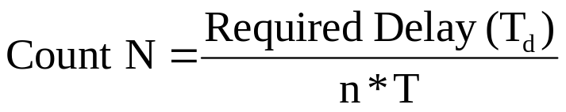
Timings and Delays
Note that it may not be possible to generate the exact time delays by this method but the delays obtained using this method are sufficiently accurate to be used in most the practical problems.
Few examples are shown for illustration:-

Slide 4
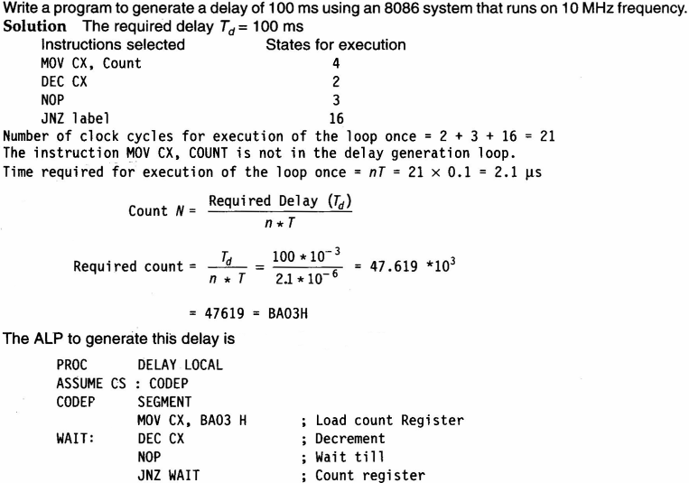

Timings and Delays (Examples)

Slide 5
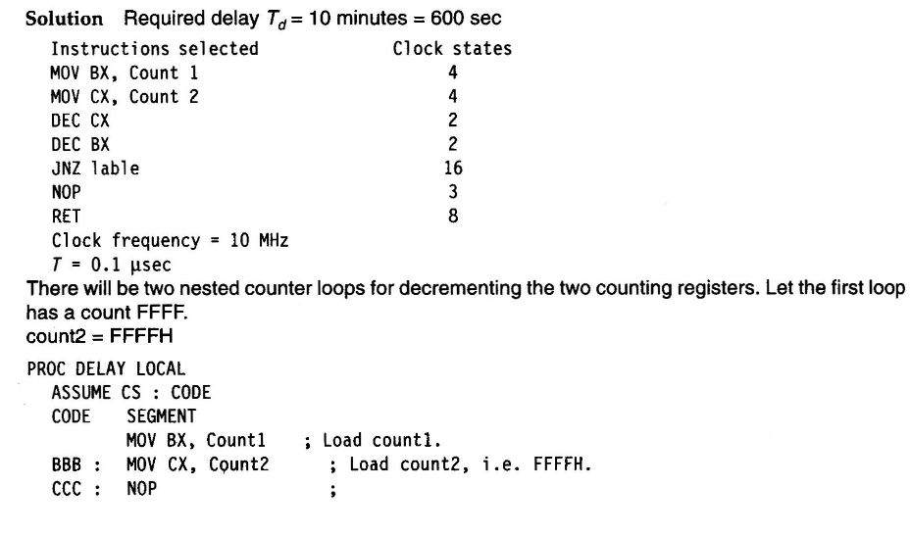
Timings and Delays (Examples)
Write a program to provide of ten minutes
Continued…

Slide 6
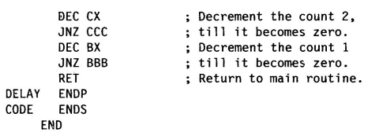
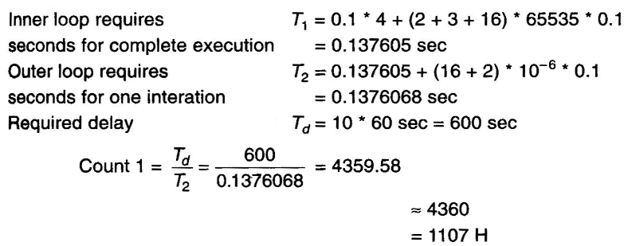
Timings and Delays (Examples)
Continued…
Delay Calculations for 10 Minutes…

